Slide 1
Section 5.3
Integration by Substitution and by Parts in Definite Integrals

Slide 2
Integration by Substitutions for definite integrals

Slide 3
Integration by Substitutions for definite integrals
Proof
Let F be an antiderivative of f on the interval I, then
Since
we have
Therefore, the formula holds.

Slide 4
Integration by Substitutions for definite integrals
Example: Evaluate
Solution
Let
. Then
when
when
; thus by the formula, we have
.

Slide 5
Integration by Substitutions for definite integrals
Example: Prove
(
is any positive integer).
Proof

Slide 6
Integration by Substitutions for definite integrals
Example: Find
Solution
Let
then
Then
So

Slide 7
Integration by Parts
Integration by parts for indefinite integrals
When u and v are differentiable functions of x, the Product Rule for differentiation tell us that
Integrating both sides with respect to x and rearranging leads to the integral equation

Slide 8
Integration by Parts
Integration by parts for definite integrals
Solution
Let
, then
,
Thus

Slide 9
Integration by Parts
Example: Evaluate
Solution
Let
then

Slide 10
Integration by Parts
Example: Evaluate
Solution

Slide 11
Integration by Parts
Example: Evaluate
Solution

Slide 12
Integration by Parts
Example: Compute the following integrals:
Solution

Slide 13
Integration by Parts
Example: Compute the following integrals:
Solution (continued)
If n is odd
If n is even
Since
we obtain

Slide 14
Integration by Parts
Example: Compute the following integrals:
Solution (continued)

Slide 15
Quadrature Problems for elementary fundamental functions
Notes:
The table of integrals is attached in the appendix.

Slide 16
Review
The Concept of definite Integrals
Integration by substitutions
Integration by parts
Quadrature Problems for elementary fundamental functions

Slide 17
Section 5.4
Improper Integrals

Slide 18
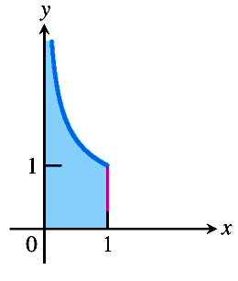
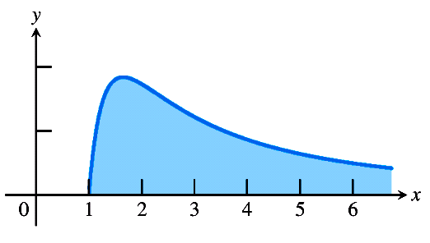
Overview
By the definition of definite integral, the definite integrals we have studied
must satisfy at least the following two conditions:
(1) The interval of integration [a, b] is finite;
(2) The integrand f is bounded on [a, b].
In practice, however, we frequently encounter problems that fail to meet one
or both of these conditions. Hence, it is necessary that we extended the concept
of definite integrals to investigate integrals with infinite interval of integration
or with an unbounded integrand.

Slide 19
Integration on an Infinite Interval
Example 1
In an electric field formed by a point charge with electric
quantity Q, find the electric potential at a point A with a distance a away from
Q.
Solution
By the knowledge of physics, the electric potential at point A,
V_{A} is equal to the work done by the electric field force when a unit positive
charge moves from point A to infinity. We now choose the coordinate system
such that the position of Q is the origin and the point A lies on the x-axis.
First, we consider the work done by the electric field force if a unit positive
charge moves from point a to point b.
Because the electric field intensity at
point x is
, which depends on the distance x,
the potential should be
computed by integration.

Slide 20
Integration on an Infinite Interval
Example 1
In an electric field formed by a point charge with electric
quantity Q, find the electric potential at a point A with a distance a away from
Q.
Solution (continued)
Partition the interval [a, b] and consider the subinterval [x, x + dx].
If the unit electric charge moves from the point x to point x + dx,
then the work done by the electric field force should be
This is the element of the work W. hence the total work when the unit electric
charge moves from point a to point b is

Slide 21
Integration on an Infinite Interval
Example 1
In an electric field formed by a point charge with electric
quantity Q, find the electric potential at a point A with a distance a away from
Q.
Solution (continued)
Obviously, to find the work when the charge moves a to infinity, we need only
to consider the limit of W as b tends to infinity. Hence,
That is,
The limit can be seen as integration over an infinite interval.

Slide 22
Integration on an Infinite Interval
Definition (Infinite integral)
Suppose that a function f is defined on the
interval [a, +∞). If for any b > a, f is Riemann integrable on the interval [a, b],
then
is called the integral of the function f on the infinite interval
[a, +∞) or simply the infinite integral of the function f, denoted by
Similarly, we have
and

Slide 23
Integration on an Infinite Interval
Geometric meaning of the infinite integral
Suppose that f(x) ≥ 0, x ∈ [a, +∞), since
express the area formed
by the curve y = f(x), the x-axis and the vertical lines x = a and x = b, it is easy
to see that the area becomes larger when b increases, so that if
exists then the area formed by the curve y = f(x), x-axis and x = a exists and
is equal to A; if
is infinity, then the corresponding area is
regarded as infinity, in this case, we say that the area does not exist.
Notes:
Draw a figure on the blackboard.

Slide 24
Integration on an Infinite Interval
Example 2
Evaluate the area formed by the curve
the line x = 1,
and the x-axis.
Solution
A

Slide 25
Integration on an Infinite Interval
Example 3
Evaluate the area formed by the curve
the line x = 1,
and the x-axis.
Solution
In this case, the limit is infinite, so
the infinite integral does not exist,
and we say that the area does not
exist.
A

Slide 26
Integration on an Infinite Interval
Definition (Convergence of infinite integrals)
Consider an infinite integral
If
exists then we say that the infinite
integral
is convergent and that A is the value of the infinite
integral,
denoted by
if
does not exist,
then
is divergent.

Slide 27
Integration on an Infinite Interval
Example 4 Determining Convergence
For what values of p does the integral
converge? When the integral
does converge, what is its value?
Solution
If
Thus,

Slide 28
Integration on an Infinite Interval
Example 4 Determining Convergence
For what values of p does the integral
converge? When the integral
does converge, what is its value?
Solution (continued)
because
Therefore, the integral converges to the value
if p > 1 and it diverges
if p < 1.

Slide 29
Integration on an Infinite Interval
Example 4 Determining Convergence
For what values of p does the integral
converge? When the integral
does converge, what is its value?
Solution (continued)
If p = 1,
and the integral diverges.

Slide 30
Integration on an Infinite Interval
Example 5
Find the integral
Solution
Finish.

Slide 31
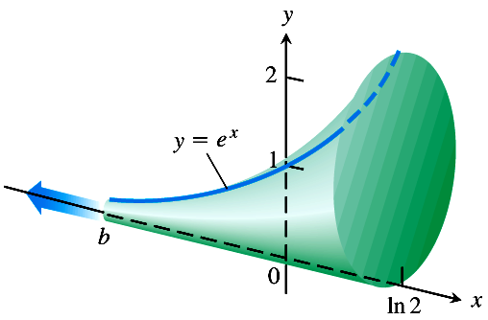
Integration on an Infinite Interval
Example 6 Finding the Volume of an Infinite Solid
The cross sections of the solid horn perpendicular to the x-axis are circular disks
with diameters reaching from the x-axis to the curve
y = e^{x},
Find the volume
of the horn.
Solution
The area of a typical cross section is
We define the volume of the horn to be the limit as of volume of the
portion from b to ln2. Thus the volume of this portion is

Slide 32
Integration on an Infinite Interval
Example 6 Finding the Volume of an Infinite Solid
The cross sections of the solid horn perpendicular to the x-axis are circular disks
with diameters reaching from the x-axis to the curve
y = e^{x},
Find the volume
of the horn.
Solution (continued)
As
and
The volume of the horn
is

Slide 33

Integration on an Infinite Interval
Example 7 Gabriel’s Horn
Can you imagine an infinitely long solid with a surface that calculates to have
an infinite area but a finite volume?
This seems like a paradox.
Evangelista Torricelli ( 1608 - 1647 ) [Greek]
Torricelli's own words fully describe his amazement at
discovering an infinitely long solid with a surface that
calculates to have an infinite area, but a finite volume.
"It may seem incredible that although this solid has an
infinite length, nevertheless none of the cylindrical surfaces
we considered has an infinite length but all of them are finite."
This "incredible" paradox prompted Torricelli to try several
alternate proofs.
Notes:
Evangelista Torricelli ( 1608 - 1647 ) was a student of Galileo,

Slide 34
Integration on an Infinite Interval
The surface of revolution of the function y = 1 / x about the x-axis for x ≥ 1.
It has finite volume
but infinite surface area, since
This lead to the paradoxical consequence that while Gabriel’s horn can be filled
up with π cubic units of paint, an infinite number of square units of paint are
needed to cover its surface!

Slide 35
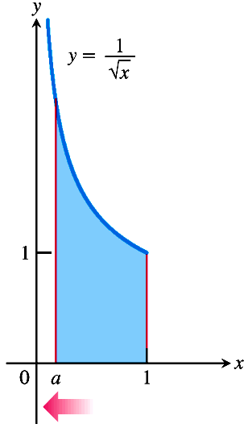
Integrands with Infinite Discontinuities
Another type of improper integral arises when the integrand has a vertical
asymptote – an infinite discontinuity – at a limit of integration or at some point
between the limits of integration.
Consider the infinite region in the first quadrant
that lies under the curve from x = 0
to x = 1.
First, we find the area of the portion from a to 1,
Then we find the limit of this area as

Slide 36
Integrands with Infinite Discontinuities
Definition (Improper Integrals with Infinite Discontinuities)
Integrals of functions that become infinite at a point whit in the interval of
integration are improper integrals.
In part 1 and 2, if the limit is the value of the improper converges and the limit is the value of the improper integral. If the limit fails to exist,the improper integral
diverges.
1. If f(x) is continuous on (a, b], then
2. If f(x) is continuous on [a, b), then
3. If f(x) is continuous on , then
In part 3, the integral on the left-hand side of the equation converges if both integrals on the right-hand side have values; otherwise it diverges.

Slide 37
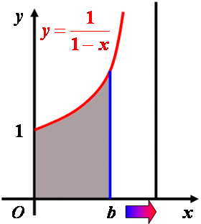
Integrands with Infinite Discontinuities
Example 8 A Divergent Improper Integral
Investigate the convergence of
Solution
The integrand f(x) = 1 / (1 – x) is continuous on [0, 1) but becomes
infinite as
We evaluate the integral as
The limit is infinite, so the integral diverges.

Slide 38
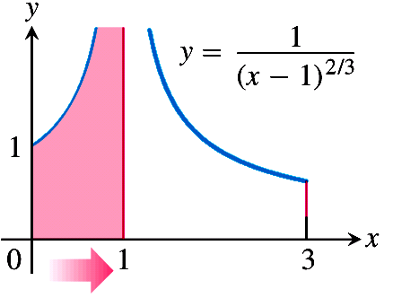
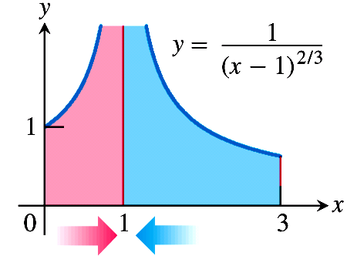
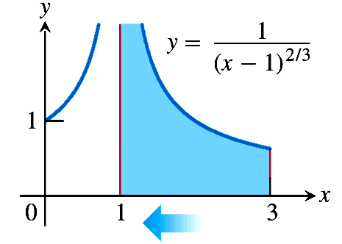
Integrands with Infinite Discontinuities
Example 9 Infinite Discontinuity at an Interior Point
Evaluate
Solution
The integrand has a infinite discontinuous point at x = 1, thus

Slide 39
Integrands with Infinite Discontinuities
Example 9 Infinite Discontinuity at an Interior Point
Evaluate
Solution (continued)
Next, we evaluate each improper integral on the right-hand side of this equation.

Slide 40
Integrands with Infinite Discontinuities
Example 9 Infinite Discontinuity at an Interior Point
Evaluate
Solution (continued)
and
We conclude that
Finish.

Slide 41
Integrands with Infinite Discontinuities
Example 10 Find the integral
Solution
Since a is a singular point of the integrand, the integral has infinite
discontinuous point.
By the definition, we have

Slide 42
Integrands with Infinite Discontinuities
Example 11 Discuss the convergence of the integral
Solution
Since a is a singular point of the integrand, it is an improper
integrands with infinite discontinuities.
When p = 1, for any ε > 0 we have
Because does not exist, is divergent if p = 1.
When ,

Slide 43
Integrands with Infinite Discontinuities
Example 11 Discuss the convergence of the integral
Solution (continued)
Hence, converges if p < 1; diverges if p ≥ 1.
Finish.

Slide 44
Improper Integrals
Example 12
Find the integral
Solution
This integral is an infinite integral.
Since x=1 is a singular point of
the integrand, it is also an improper integrands with infinite discontinuities.
We can rewrite it in the form
Since

Slide 45
Improper Integrals
Example 12
Find the integral
Solution (continued)
Then
Finish.

Slide 46
Improper Integrals
Example 13
The improper integral
Note: The improper integral
is convergent.
The value of the improper integral is a function of the parameter
denoted by
Gamma function
The function satisfies the following recurrence relation:

Slide 47
Improper Integrals
Taking
we have
Since
we obtain that
or

Slide 48
Review
Integration on an infinite interval
Integrals of Infinite Discontinuities

